Slide 1
CapBand: Battery-free Successive Capacitance Sensing Wristband for Hand Gesture Recognition
Hoang Truong, Shuo Zhang, Ufuk Muncuk, Phuc Nguyen, Nam Bui, Anh Nguyen, Qin Lv, Kaushik Chowdhury, Thang Dinh, Tam Vu
Notes:
Thanks for the introduction Jacob
Good morning, everyone. Today, I would like to bring to our sensing community some new exciting finding and results on the topic of hand gesture recognition.
I would like to introduce CapBand system: a Battery-free Successive Capacitance sensing wristband for Hand gesture recognition.
This is the work with my amazing team under the brilliant supervising of Christine, Kaushik and my advisor, Tam Vu

Slide 2
Hand Gesture Recognition
Notes:
Having a gesture recognition system in wristband-form-factor or integration into smartwatch enables wide range of application
For example, using in VR or Gaming environment

Slide 3
Hand Gesture Recognition
Notes:
controlling in automotive infortainment system

Slide 4
Hand Gesture Recognition
Notes:
hand-free applications in smart home

Slide 5
Hand Gesture Recognition
Notes:
and robotic controlling.

Slide 6
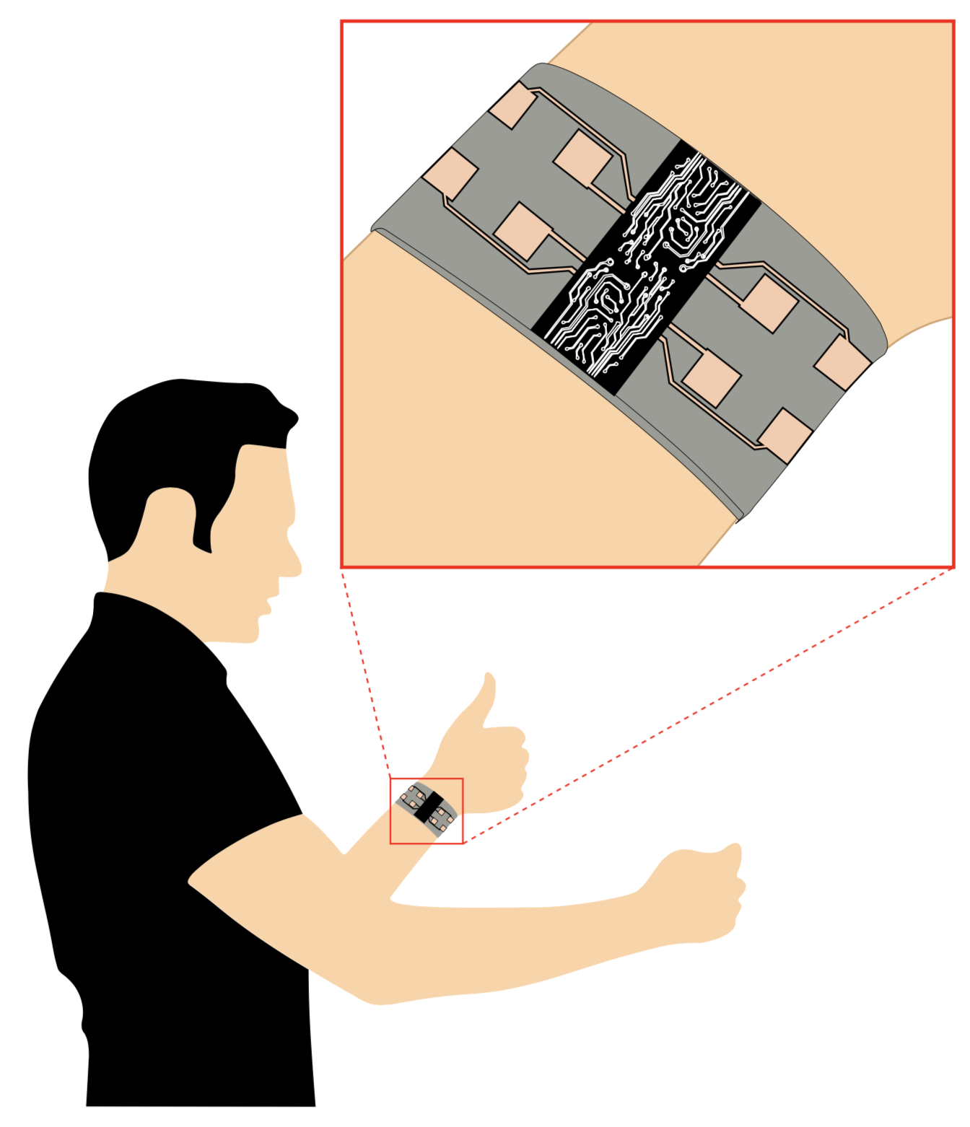
Hand Gesture Recognition – Expectation
Highly accurate and robust recognition
Rich gesture set
Low power consumption
Indoor & outdoor operation
Notes:
Thus, in order to adapt into those application, there are common expectation and criteria for those hand gesture recognition system:
It should perform highly accurate and robust recognition,
Having a rich-gesture set
Consume low-power
And Operate in various environment (both indoor and outdoor)

Slide 7
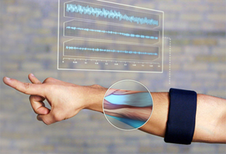
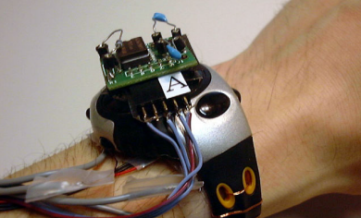
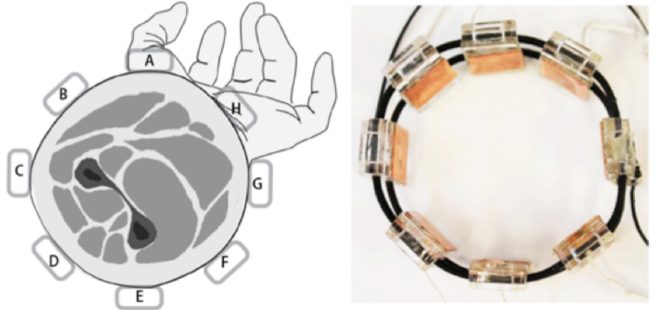
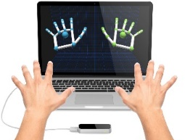
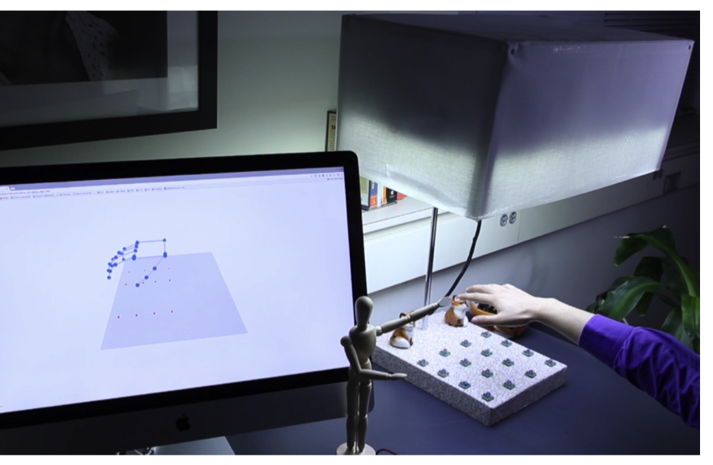
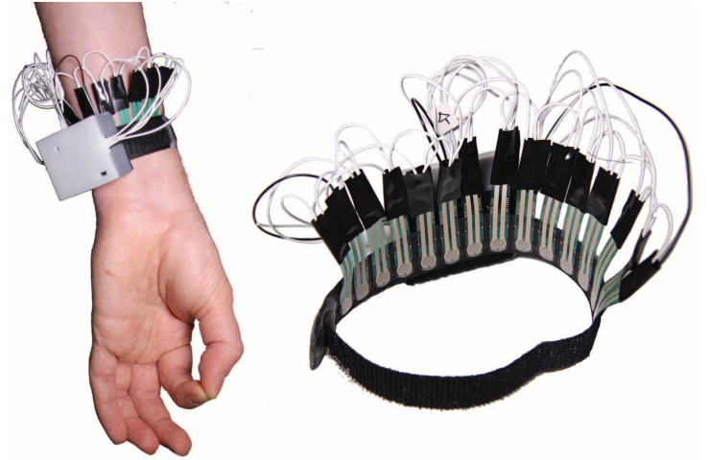
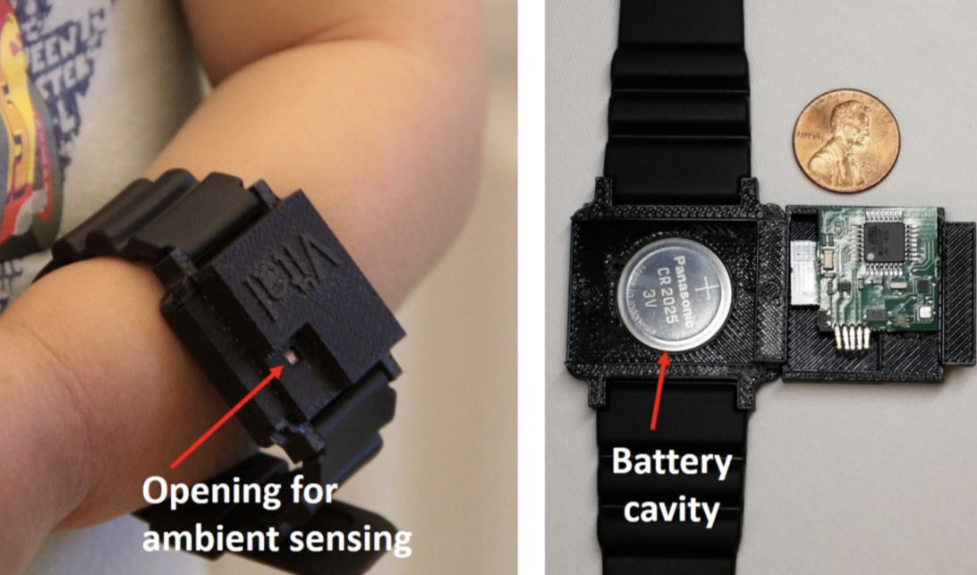
State-of-the-art Systems
On-body Sensors
…
Myo
GestureWrist
Tomo
Off-body Sensors
…
Leap Motion
Depthsense
Visible Light
…
Low-power System
Wristflex
Wristband Vital
Allsee
Notes:
State of the art gesture recognition systems can be classified into following categories:
on-body sensors use different approach of MEG, pressure sensors, capacitance sensors and impedance tomography
Off-body sensors use IR, camera or visible light
Some notable low-power gesture recognition systems include Wristflex, WristbandVital and Allsee

Slide 8
Problem statement
Frequent recharging requirement
Per-use training or re-calibration
Notes:
However, most of those systems have the same 2 common issues
First, they require frequent recharging daily or battery replacement after long time usage due to the power hungry of continuously multiple signal streaming in order to capture complex gestures performed by users
Second, they require the per-usage training or re-calibration of the system because every time a user puts the device on, it may be at a position that is slightly different from the position that the device was trained for

Slide 9
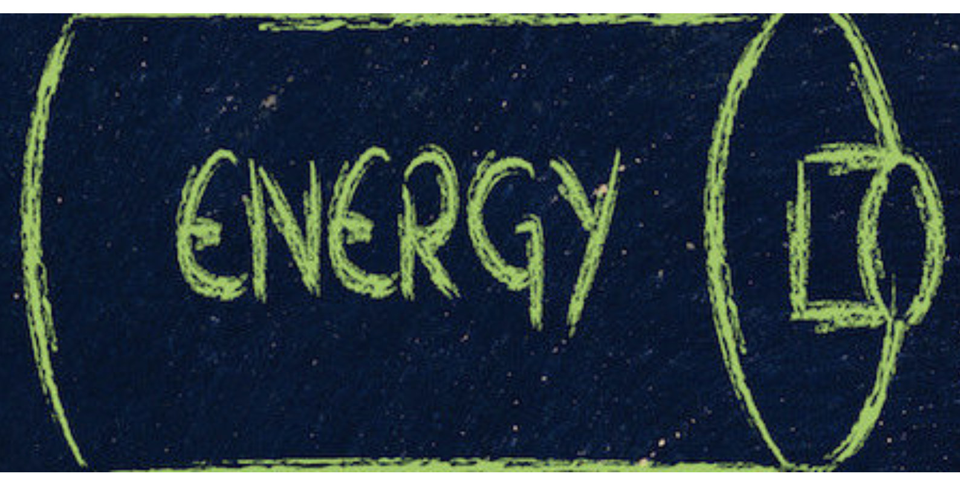
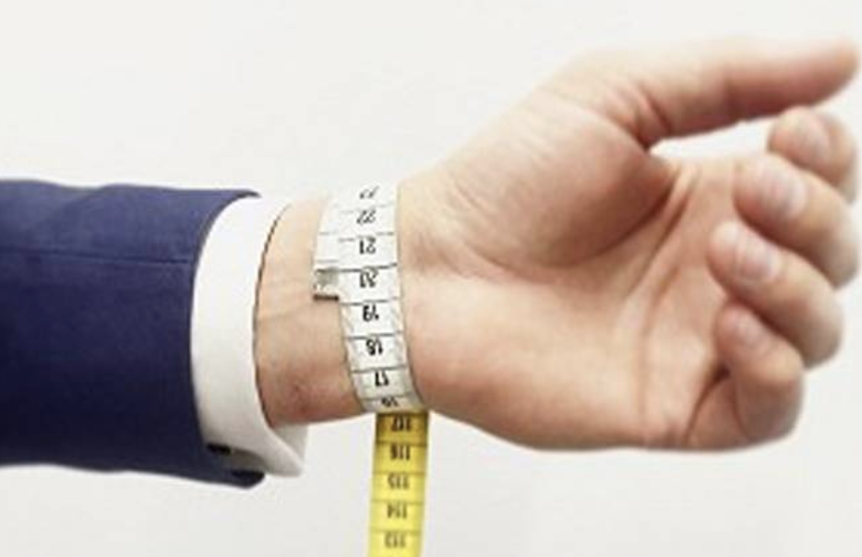
Challenges
Challenge #1: Minimize required energy to
sense useful hand gestures
Challenge #2: Ensure reliable hand gesture recognition without per-use training
Challenge #3: Consistent performance across user due to wrist size variation
Notes:
To address those 2 fundamental problem at the same time, there are some challenges:
1st, to minimize the required energy to sense useful hand gestures so that the device can be powered by the limited energy harvestable from the surrounding environment
2nd, we have to ensure the reliable hand gesture recognition without per-use training
And 3rd, we must have the consistent performance across user due to the nature of wrist size variation

Slide 10
We proposed CapBand
Battery-free successive capacitance sensing
gesture recognition wristband
Ultra-low-power sensing
Reliable gesture recognition
On-wrist localization
Battery-free scheme
Notes:
In order to solve the problems, overcome those challenges and satisfy the common criteria for the hand gesture recognition system,
We propose Capband, a battery-free successive capacitance sensing gesture recognition wristband.
This system provides:
an ultra-low-power-sensing technique to capture small skin movements on the user’s wrist
a reliable gesture recognition based on the analyze of human wrist and hand gesture anatomy to deal with the hybrid data of static and motion gesture
An on-wrist sensor localization to eliminate the needs of re-calibration of per-use traning
The battery-free operation where we show the feasibility of using the system under battery-free scheme

Slide 11
CapBand overview
Notes:
The ultra-low-power sensing is achieved by our dedicated sensor design and sensing hardware.

Slide 12
CapBand overview
Notes:
We have an energy management module to scavenge energy from surrounding environment and provide stable power for the sensing hardware.

Slide 13
CapBand overview
Notes:
Upon receive streaming of sensing signal from the hardware, the system software side executes the on-wrist sensor localization in order to ensure the user is wearing the wristband at the correct position

Slide 14
CapBand overview
Notes:
Then performs the gesture recognition simply by calling upon a pre-trained model.

Slide 15
CapBand
Battery-free successive capacitance sensing
gesture recognition wristband
Ultra-low-power sensing
Reliable gesture recognition
On-wrist localization
Battery-free scheme
Notes:
Let’s talk about the ultra-low-power sensing aspects

Slide 16
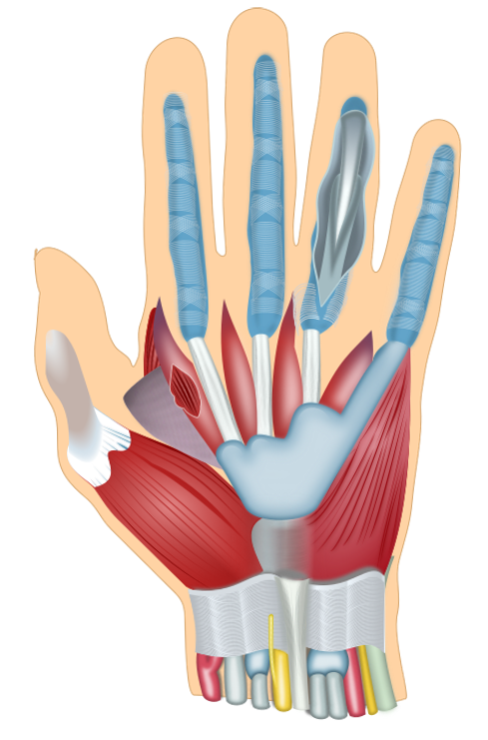
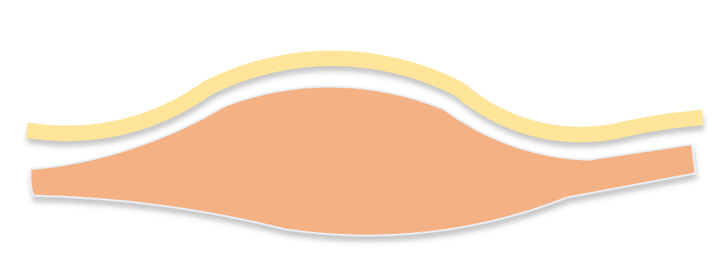
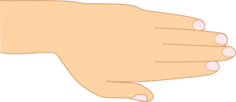
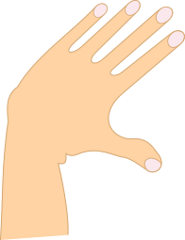
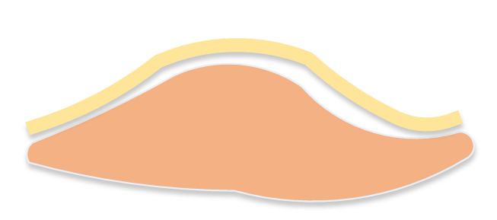
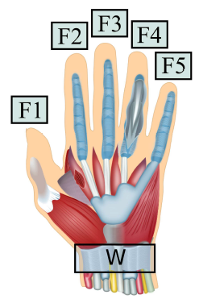
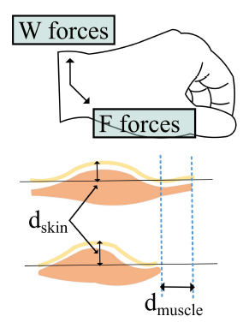
Wrist Muscle and Gesture Anatomy
Muscle contraction
Notes:
The idea comes from the analyzing of wrist muscle and gesture anatomy.
Let’s see the example of this wrist area and corresponding underlying muscle and skin while the hand is at the rest position.
When the gesture changes, it causes the contraction of muscle in that area

Slide 17
Wrist Muscle and Gesture Anatomy
Skin deformation
Notes:
Which will lead to the tiny skin deformation there.

Slide 18
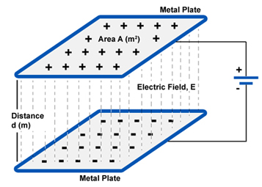
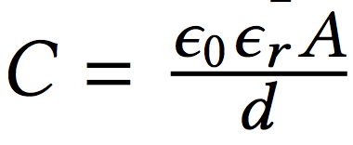
Sensing Technique
Human skin
Sensor layer – 1
Padding material
d
Sensor layer – 2
Capacitance sensing
Permitivity
Area size
Capacitance
Distance b/w 2 plates
Notes:
We pursue the capacitance sensing approach to capture those tiny skin movement..
Over human skin will be 2 sensor layers which are considered as two side of capacitor that has area A, the distance d.
The capacitance can be calculated as following. The permittivity epsilon 0 and epsilon R are defined by the padding material properties.
When the skin surface is deformed, it changes the distance d. This event will create the capacitance variation captured by our sensing hardware..

Slide 19
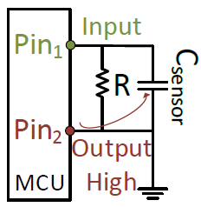
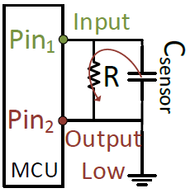
Ultra-low-power Sensing
Capacitance sensing techniques
RC-oscillator-based mechanism
Notes:
There exists multiple methods to measure those capacitance change, which utilizes different approach of using the change in frequency, voltage, charging, and has the current consumption in the uA range
We turn our interest to the RC-oscillator based mechanism where the measurement is inferred from the charge and discharge time of the capacitance of the sensor
This measurement requires a small setup which costs only 2 GPIO pins of the MCU under simple operation of switching the pin number 2 here between High and Low state in order to count the charge and discharge time of the capacitance sensor.

Slide 20
Ultra-low-power Sensing
GPIO flicking consumes current at pA-order
Capacitance sensing techniques
RC-oscillator-based mechanism
Notes:
The finding here is that GPIO flicking consumes extremely low power.

Slide 21
Successive Ultra-low-power Sensing
Sensor array increases the sensitivity
MUX operation reduces power consumption
with low switching overhead
Notes:
In order to increase the sensitivity of the system, it is necessary to use multiple sensors where we integrate them into the sensor array.
Then, in order to minimize the power consumption of measuring this capacitance sensor array, we utilize the multiplexer here with low MUX switching overhead operation.

Slide 22
Power consumption
Average power of sensor measurement
Current profile during 15 measurements
Notes:
Here are the average power consumption and current profile during 15 measurements
You can see the average power consumption is only 300uW at highest sampling rate of our hardware

Slide 23
Sensor Design
Copper plate
Copper plate
Notes:
From the fundamental knowledge of a capacitor which if formed from 2 parallel plates, we fabricate each sensor from 2 parallel copper plates

Slide 24
Sensor Design
1st layer connects to fixed ground
2nd layer connects to measurement pin
Notes:
Then we duplicate the same design into this sensor array and configure the connection of those 2 layers

Slide 25
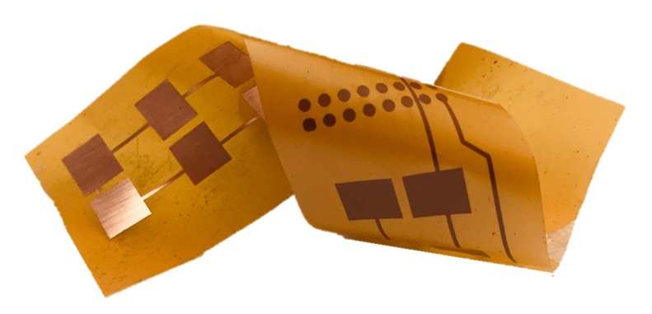
Sensor Design
1st layer connects to fixed ground
Resolve problem of floating ground
2nd layer connects to measurement pin
Fabricate with flexible property
Notes:
This wiring configuration helps to resolve the problem of floating ground – the most prominent problem in capacitance sensing based technique
In addition, we fabricate this sensor array with flexible properties with the desire of weaving our low-cost sensor into off-the-shelf, commercial wristband and smartwatch in the future.

Slide 26
Heterogeneous wristband
3-layer design
Notes:
In order to hold those 2 sensor array layers, we design and fabricate the heterogeneous wristband using 3 silicone layer with different hardness
Where the middle is from softest silicone in order to be highly sensitive to the tiny change due to skin deformation

Slide 27
Heterogeneous wristband
3-layer design
Consistent padding distance
Notes:
In addition, the middle layer must have consistent thickness at fabrication to ensure the consistence padding distance d

Slide 28
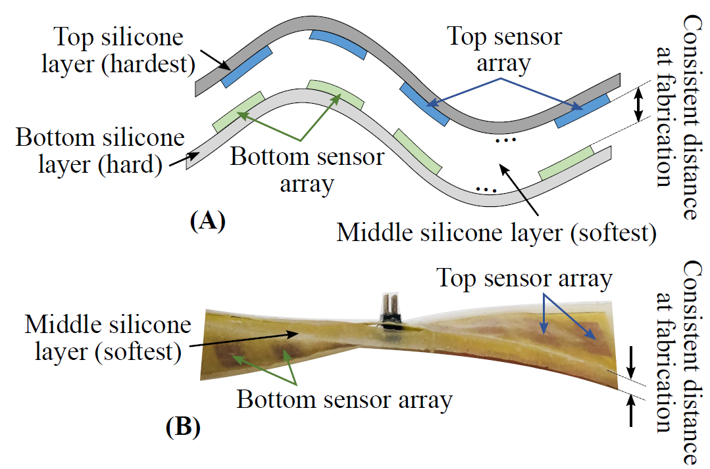
Heterogeneous wristband
Corresponding fabrication
Notes:
As the result, here is the silicone band which holds the flexible sensor arrays as described above.

Slide 29
CapBand
Battery-free successive capacitance sensing
gesture recognition wristband
Ultra-low-power sensing
Reliable gesture recognition
On-wrist localization
Battery-free scheme
Notes:
Having the sensitive and dedicated sensor and sensing hardware, we are now looking for the appropriate gesture recognition approach.

Slide 30
Gesture Set
15 common gestures
Notes:
We defined a gesture set including 15 common gestures which are useful and popular in multiple hand gesture applications

Slide 31
Gesture Set
15 common gestures
Highly-sensitive sensors
Notes:
The sensor array show the high sensitivity while measuring with those defined gestures. These 15-bars on top each gesture here represent the capacitance measurement of the corresponding 15 sensors

Slide 32
Gesture Set
15 common gestures
Highly-sensitive sensors
Easy to classify
Simple classifications yield high accuracy:
SVM – 89.6%
RFC – 92.5%
Notes:
Owe to the distinguish and sensitive measurement, the gesture set is very easy to classify. Testing with simple classification methods already give high accuracy.
For example 89.6% with svm and 92.5% with random forest.

Slide 33
Reliable Classification – CNN-based
Taking into account hybrid data: static gesture and motion gesture
CNN is sensitive for detecting edge pattern
Robust with varying speeds and magnitudes while making gestures
Two-layer convolutional structure
Prevent overfitting problem
Pre-train model and deploy on smartphone
Enable low-latency real-time recognition
Notes:
In order to boost the accuracy and ensure the reliable classification, we investigate the CNN-based classification
Due to the sensitivity of CNN in detecting edge pattern, we take into account the hybrid data of hand gesture which include both static gesture and motion gesture.
In addition, this classification is robust with the varying speeds and magnitudes while making gestures.
We construct 2-layter convolution structure in order to prevent the overfitting problem
We pre-train the CNN model and deploy on smartphone in order to enable the low-latency real-time recognition

Slide 34
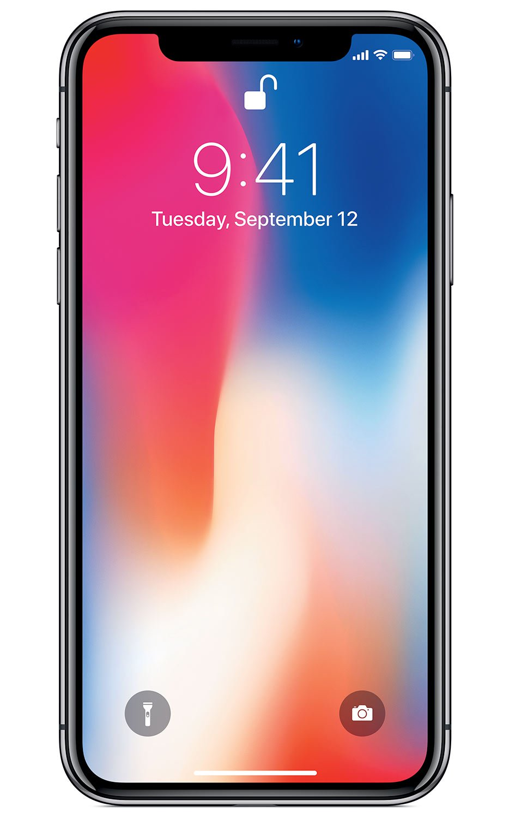
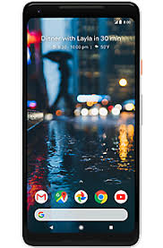
Reliable Classification – CNN-based
Taking into account hybrid data: static gesture and motion gesture
Detailed configurations are in our paper & open-source repo
CNN is sensitive for detecting edge pattern
Feasibility of real-time deployment on smartphone
Robust with varying speeds and magnitudes while making gestures
Two-layer convolutional structure
Prevent overfitting problem
Pre-train model and deploy on smartphone
Enable low-latency real-time recognition
iPhoneX iOS 11.3
1.5ms/reg
GG Pixel 2 – Android 8.1 Oreo API 27 7.8ms/reg
Notes:
Please refer our paper and github for detail configuration
We tested the feasibility of real-time deployment on smartphone where the software on iOS and Android has the latency of 1.5ms and 7.8ms for each recognition pass.

Slide 35
CapBand
Battery-free successive capacitance sensing
gesture recognition wristband
Ultra-low-power sensing
Reliable gesture recognition
On-wrist localization
Battery-free scheme
Notes:
To achieve higher gesture recognition accuracy and better user experience, proper positioning of CapBand on users’ wrist is essential.
While it is relatively easy to point out that the wristband is in the wrong position, it would be much more useful (and user-friendly) to determine the specific (incorrect) position so the user can adjust accordingly

Slide 36
On-wrist Sensor Localization
F3
F4
F2
F5
F1
W
Force components and decision function
Pre-defined sensors locations
Multivariate Gaussian kernel
Notes:
From the wrist and gesture anatomy, we build the wrist-muscle-to-gesture model in order to define the force components from the finger and wrist that compose a specific gesture
That gives us the insight to decide the sensor location on the wrist and define the correct wristband position
We then solve the problem of on-wrist sensor localization using the multivariate gaussian kernel-based classification

Slide 37
On-wrist Sensor Localization
F3
F4
F2
F5
F1
Eliminate the per-use training or re-calibration
W
Force components and decision function
Ore-defined sensors locations
Multivariate Gaussian kernel
Notes:
You can refer to our paper for the detail of model formulation and localization algorithm

Slide 38
CapBand
Battery-free successive capacitance sensing
gesture recognition wristband
Ultra-low-power sensing
Reliable gesture recognition
On-wrist localization
Battery-free scheme
Notes:
The final aspect of our system is to operate under the limited energy harvested from surrounding environment.

Slide 39
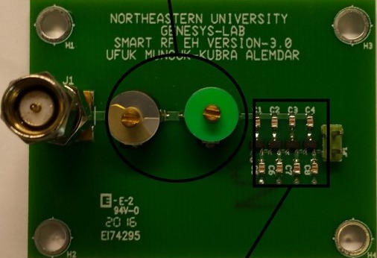
Transient Power Management
RF-based: big form-factor, require dedicated transmitter
Solar cell-based: versatile, multiple schemes
Control charge & discharge threshold
Stable output
Notes:
We design the energy harvesting module and test the front-end feasibility under RF-based and solar-cell-based prototype.
The RF-based approach requires big antenna form factor and a dedicated RF transmitter to ensure enough high-receive power.
The solar-cell-based approach show the versatile to operate under both schemes of harvest-then-use and harvest-then-use-later
The energy module has the capability of control the charge and discharge threshold of energy sink and provide stable output to the sensing hardware.

Slide 40
Transient Power Management
RF-based: big form-factor, require dedicated transmitter
Solar cell-based: versatile, multiple schemes
Control charge & discharge threshold
Stable output
Battery-free operation
Notes:
We design the energy harvesting module and test the front-end feasibility under RF-based and solar-cell-based prototype.
The RF-based approach requires big antenna form factor and a dedicated RF transmitter to ensure enough high-receive power.
The solar-cell-based approach show the versatile to operate under both schemes of harvest-then-use and harvest-then-use-later
The energy module has the capability of control the charge and discharge threshold of energy sink and provide stable output to the sensing hardware.

Slide 41
Putting together
15-gesture set
95.3% localization accuracy
95% recognition accuracy
Battery-free operation
Notes:
Putting all pieces together, we have the wristband-form-factor system which can recognize a 15-gesture set at 95% accuracy, 95.3% for localization accuracy and running with solar-cell-energy harvesting.

Slide 42
Gesture Recognition Performance
Notes:
We evaluate the system performance with 23 subjects.
The highest accuracy is achieved with CNN-based approach at 95.1%

Slide 43
On-Wrist Localization Performance
Notes:
The on-wrist sensor localization has the average of 95.3% accuracy

Slide 44
CapBand conclusion
Battery-free successive capacitance sensing
gesture recognition wristband
Ultra-low-power sensing
Reliable gesture recognition
On-wrist localization
Battery-free scheme
Notes:
In order to solve the problems, overcome those challenges and satisfy the common criteria for the hand gesture recognition system,
We propose Capband, a battery-free successive capacitance sensing gesture recognition wristband.
This system provides:
an ultra-low-power-sensing technique to capture small skin movements on the user’s wrist
a reliable gesture recognition based on the analyze of human wrist and hand gesture anatomy to deal with the hybrid data of static and motion gesture
An on-wrist sensor localization to eliminate the needs of re-calibration of per-use traning
The battery-free operation where we show the feasibility of using the system under battery-free scheme

Slide 45
Future works
Sensor and hardware miniaturization
Integration into OTS smartwatches or smartbands
Extend the utilization of skin deformation sensing technique:
Respiration rate measurement system
Facial skin deformation sensing
Extend gesture set, improve accuracy & robustness

Slide 46
CapBand Q&A
Battery-free successive capacitance sensing
gesture recognition wristband
Ultra-low-power sensing
Reliable gesture recognition
On-wrist localization
Battery-free scheme

Slide 47
CapBand: Battery-free Successive Capacitance Sensing Wristband for Hand Gesture Recognition
Hoang Truong, Shuo Zhang, Ufuk Muncuk, Phuc Nguyen, Nam Bui, Anh Nguyen, Qin Lv, Kaushik Chowdhury, Thang Dinh, Tam Vu
Notes:
Thanks for the introduction Jacob
Good morning, everyone. Today, I would like to bring to our sensing community some new exciting finding and results on the topic of hand gesture recognition.
I would like to introduce CapBand system: a Battery-free Successive Capacitance sensing wristband for Hand gesture recognition.
This is the work with my amazing team under the supervising of Christine, Kaushik and my advisor, Tam Vu

